Slide 1
Lec # 14
Course: Data Science Tools & Techniques
Instructor: Dr. Mateen Yaqoob

Slide 2
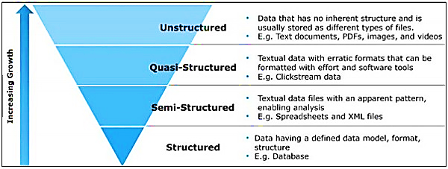
Data Types
Type | Example | Storage | Tools
Structured | Tables, Databases | SQL | Pandas, SQL
Semi-structured | JSON, XML | NoSQL | MongoDB, Spark
Unstructured | Text, Images, Audio | Files, Cloud | Hadoop, NLP libs

Slide 3
Structured Data: SQL & Pandas Workflow
•
Fixed Schema: Strict column types enforced on write.
import sqlite3
import pandas as pd
conn = sqlite3.connect("enterprise_sales.db")
query = """
SELECT region, COUNT(*) AS tx_count, AVG(revenue) AS avg_rev
FROM transactions
WHERE tx_date >= '2026-01-01'
GROUP BY region
"""
df = pd.read_sql_query(query, conn)
print(df.head())
•
ACID Transactions: High relational integrity across tables.
•
Fast Aggregations: Indexed SQL queries feed DataFrames.
•
Direct ML Readiness: Tabular matrices require minimal structural parsing.

Slide 4
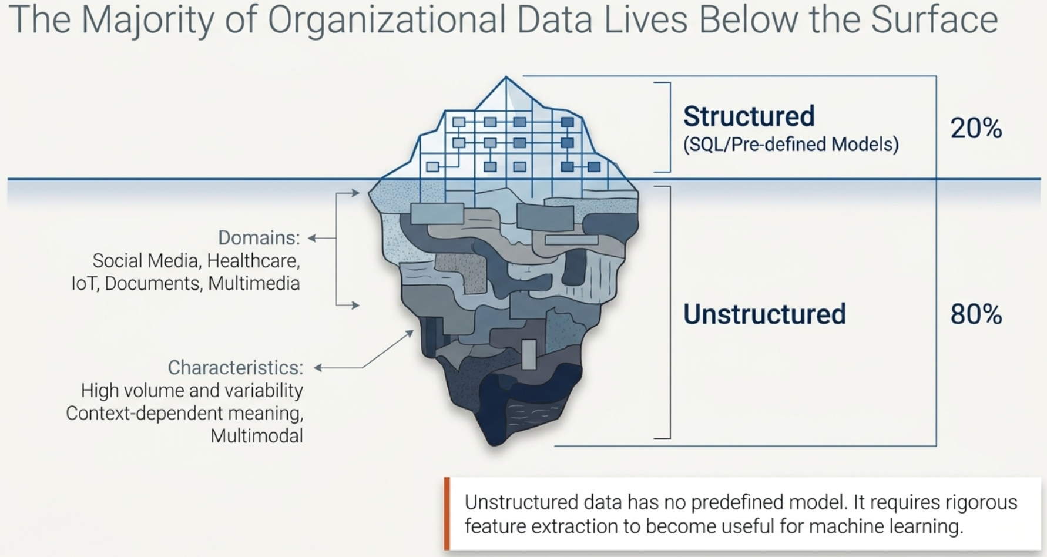

Slide 5
Unstructured Data
Data that does not have a pre-defined data model or is not organized in a pre-defined manner.
The majority of an organization's data is unstructured.
Domains: social media, healthcare, multimedia, IoT, documents
Notes:
Definition: Data that does not have a pre-defined data model or is not organized in a pre-defined manner.
Contrast with Structured Data: Tables, rows, columns, SQL databases.
Analogy:
Structured: A library with a Dewey Decimal System.
Unstructured: A box of photos, handwritten letters, and audio recordings.

Slide 6
Characteristics of Unstructured Data
High volume and variability
Context-dependent meaning
Harder to query and preprocess
Often multimodal (text + image + audio)

Slide 7
Challenges
Storage and scalability
Data cleaning and annotation
Feature extraction
Integration into ML pipelines
Notes:
Storage and Scalability: Unstructured data — like text, images, video, audio, or logs — doesn’t fit neatly into relational database tables. It can be massive in size, heterogeneous in format, and grows continuously (e.g., social media, IoT devices, enterprise documents).
Key Challenges:
Volume Explosion: Images, videos, and logs require terabytes to petabytes of space.
Heterogeneous Formats: Data comes in text, JSON, CSV, image, and binary formats that need different handling.
Scalability: Traditional RDBMSs are inefficient; distributed storage (HDFS, AWS S3, Google Cloud Storage) is essential.
Latency and Access: Querying large unstructured repositories is slow without indexing or specialized tools (e.g., Elasticsearch).
Versioning and Duplication: Maintaining different data versions or duplicates across distributed systems is difficult.
2. Data Cleaning and Annotation
🔹 Description:
Unstructured data is messy — text may contain spelling errors, images can be noisy, audio has background disturbances, and metadata may be missing or inconsistent. Cleaning and labeling (annotation) is often the most time-consuming part of any unstructured data pipeline.
🔹 Key Challenges:
Noise and Redundancy: Removing duplicates, noise, or irrelevant content is hard without domain context.
Incomplete Metadata: Many files lack timestamps, sources, or meaningful names.
Human Annotation Cost: Labeling text sentiment, bounding boxes in images, or transcribing audio requires expert input and is expensive.
Ambiguity: Natural language ambiguity (e.g., sarcasm) and visual context make consistent labeling difficult.
3. Feature Extraction
🔹 Description:
Raw unstructured data (pixels, words, sounds) must be transformed into numeric representations that ML models can process. This process — feature extraction or embedding — is non-trivial and domain-specific.
🔹 Key Challenges:
High Dimensionality: Text and images produce large feature spaces, increasing computation and risk of overfitting.
Loss of Semantic Meaning: Simple techniques (e.g., TF-IDF) miss contextual relationships.
Domain Dependence: Features that work for text don’t apply to images or audio.
Computational Cost: Deep feature extraction (e.g., BERT, ResNet) is GPU-intensive.
Feature Drift: Representations may change over time as language or visual content evolves.
4. Integration into ML Pipelines
🔹 Description:
Unstructured data workflows are multi-stage and complex — involving collection, preprocessing, feature extraction, training, evaluation, and deployment. Integrating all of these stages smoothly into a reproducible and scalable ML pipeline is challenging.
🔹 Key Challenges:
Heterogeneous Inputs: Text, image, and audio data often require separate preprocessing pipelines.
Inconsistent Data Formats: Outputs of one stage (e.g., image embeddings) may not directly fit into another.
Pipeline Orchestration: Managing dependencies, versioning, and scheduling in large-scale workflows.
Model Reproducibility: Difficulty reproducing results when preprocessing scripts or annotations change.
Operationalization (MLOps): Integrating models into production systems with monitoring, retraining, and CI/CD.

Slide 8
Solutions
Storage and scalability
  Distributed Storage: HDFS, Amazon S3, Google Cloud Storage
  Scalable Databases: MongoDB
Data cleaning and annotation
  Text and image preprocessing: NLTK, OPENCV, TensorFlow ImageDataGenerator
  Annotation tool: Amazon SageMaker Ground Truth
Feature extraction
  BERT embeddings, CNN feature maps (ResNet, VGG, EfficientNet)
Integration into ML pipelines
  Orchestration: Airflow, Kubeflow, MLflow
  Containerization: Docker, Kubernetes
Notes:
1. Storage and Scalability
🔹 Description:
Unstructured data — like text, images, video, audio, or logs — doesn’t fit neatly into relational database tables. It can be massive in size, heterogeneous in format, and grows continuously (e.g., social media, IoT devices, enterprise documents).
🔹 Key Challenges:
Volume Explosion: Images, videos, and logs require terabytes to petabytes of space.
Heterogeneous Formats: Data comes in text, JSON, CSV, image, and binary formats that need different handling.
Scalability: Traditional RDBMSs are inefficient; distributed storage (HDFS, AWS S3, Google Cloud Storage) is essential.
Latency and Access: Querying large unstructured repositories is slow without indexing or specialized tools (e.g., Elasticsearch).
Versioning and Duplication: Maintaining different data versions or duplicates across distributed systems is difficult.

Slide 9
Example (Text Data)
import nltk
from sklearn.feature_extraction.text import TfidfVectorizer
docs = [“This text is helpful", “It helps understand the data science"]
vectorizer = TfidfVectorizer()
X = vectorizer.fit_transform(docs)
print(vectorizer.get_feature_names_out())
print(X.toarray())
Notes:
TfidfVectorizer is from scikit-learn, and it converts a collection of text documents into a TF-IDF (Term Frequency–Inverse Document Frequency) representation — a numerical representation useful for machine learning models.
Creating Docs: This is your corpus — a list of two short documents (sentences).
TF-IDF will treat this as two documents and analyze word frequencies across them.
The TfidfVectorizer:
Tokenizes the text into words.
Removes punctuation and converts all text to lowercase.
Computes TF-IDF values for each word in each document.
fit() → learns the vocabulary (unique words) from all documents.
transform() → converts each document into a numerical vector using that vocabulary.
The result X is a sparse matrix where each row represents a document and each column a word.
After that we are viewing the names of features (unique words).
Converts the sparse matrix to a dense (regular) NumPy array for readability.
Each row corresponds to a document.
Each column corresponds to one of the feature words.

Slide 10

Statistical Text Weighting: How TF-IDF Works
•
Term Frequency (TF): Counts term occurrences inside document.
•
Document Frequency (DF): Documents containing the target term.

Slide 11
Understanding TF-IDF
TF-IDF estimates how informative a term is in one document relative to a collection of documents.
Term Frequency (TF)
Inverse Document Frequency (IDF)
How often does the term occur in this document?
Higher TF can increase the score.
How rare is the term across the collection?
Terms found in many documents get lower IDF.
TF-IDF = TF × IDF

Slide 12
The formula and its variables
We will use base-10 logarithms and raw term counts for hand calculation.
Symbols
Why add 1?
t = term (word)
d = document being scored
N = total number of documents
DF(t) = number of documents containing t
TF(t, d) = count of t in document d
Smoothing keeps the denominator nonzero and prevents unseen terms from causing division by zero. The +1 in the numerator is part of this smoothed variant.
Note: the logarithm base must be stated; this example uses log₁₀.

Slide 13
Step 1 — Create a document collection
Document 1
Document 2
Document 3
machine learning improves prediction
machine learning analyzes data
machine learning supports healthcare
Goal: compare the importance of “machine” and “prediction” in Document 1.
Both terms occur once in Document 1, but they appear in different numbers of documents.

Slide 14
Step 2 — Calculate TF and DF
Term | Document 1 | Document 2 | Document 3 | DF(t)
machine | Yes | Yes | Yes | 3
prediction | Yes | No | No | 1
Term Frequency in Document 1
Document Frequency
TF(machine, D1) = 1
TF(prediction, D1) = 1
DF(machine) = 3
DF(prediction) = 1
TF counts occurrences within one document; DF counts documents containing the term.

Slide 15
Step 3 — Calculate IDF
N = 3 documents
For “machine” (common term)
For “prediction” (distinctive term)
IDF(machine) = log₁₀[(1 + 3) / (1 + 3)]
= log₁₀(4 / 4)
= log₁₀(1)
= 0
IDF(prediction) = log₁₀[(1 + 3) / (1 + 1)]
= log₁₀(4 / 2)
= log₁₀(2)
≈ 0.3010
Interpretation: “machine” occurs in every document, so its IDF is 0 in this formula; “prediction” is rarer and gets a higher IDF.

Slide 16
Step 4 — Calculate the final TF-IDF scores
machine
prediction
TF-IDF(machine, D1)
= TF × IDF
= 1 × 0
= 0.000
TF-IDF(prediction, D1)
= TF × IDF
= 1 × 0.3010
= 0.3010
Final comparison
machine
0.000
prediction
0.301

Slide 17
Lesson Learned
Core intuition
Applications
• TF rewards terms used more in a document.
• IDF downweights terms spread across many documents.
• TF-IDF highlights terms that are frequent locally but less common globally.
• Search and document ranking
• Text classification
• Information retrieval
• Similarity and feature engineering
Important implementation note
This worked example uses raw TF and log base 10. In scikit-learn, TF is normalized by default and smoothed IDF uses the natural logarithm plus 1: IDF(t) = ln[(1 + N)/(1 + DF(t))] + 1. Scores therefore differ.

Slide 18
Pipeline for Unstructured Data

Slide 19
Examples
For more examples, see the Git repo below
https://github.com/mateenyaqoob/tf-idfexamples

Slide 20
Class Task
You are provided with the following repo and the tasks are mentioned.
  https://github.com/mateenyaqoob/unstructuredata_tfidf_repo

Slide 21
Any Questions ?

